Slide 1
CHAPTER 2
ENCODING
HEXA/BINARY

Slide 2


HOMEWORK
15 MIN
HOMEWORK REVIEW
Just 1 example per question !!

Slide 3

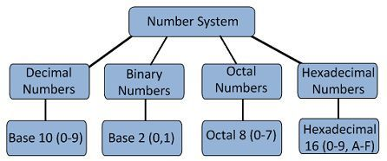
OBJECTIVES FOR TODAY
TODAY
LAST WEEK
Be able to write values in binary / octal / hexadecimal bases

Slide 4

PRESENTATION
In base 2 (binary), a slot is called a bit
CLASS
SLOT
= A BIT
1
1
1
2^2
2^1
2^0
2
1
0

Slide 5




DISCUSSION
How many bits to you need to express
GROUP 2
A DAY OF THE WEEK
5 MIN
?
?
?
Notes:
A day of the week is: 1 week is 7 days 7 = 111 (1 bit = 1 slot) so mean the day of the week is 3 bits.

Slide 6
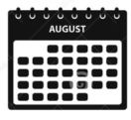
DISCUSSION
How many bits to you need to express
5 MIN
GROUP 2
A DAY OF THE MONTH ?
?
?
?

Slide 7
DISCUSSION
How many bits to you need to express
5 MIN
GROUP 2
A DAY OF THE YEAR?
From 1 to 365
?
?
?

Slide 8
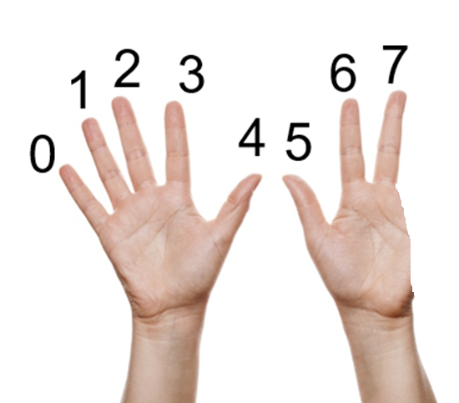
PRESENTATION
An octal value is expressed with 08 digits
CLASS
Each SLOT contains values from 0 to 7

Slide 9
PRESENTATION
Base 8 (octal) to Base 10 (decimal)
CLASS
14
BASE 8
= 1*8^1 + 4*8^0
1
4
= 8 + 4
= 12
8^4
8^3
8^2
8^1
8^0
BASE 10
4
3
2
1
0

Slide 10
QUESTION
Convert this number to base 10
5 MIN
ONE
251
BASE 8
=
=
2
5
1
=
BASE 10
8^4
8^3
8^2
8^1
8^0
4
3
2
1
0

Slide 11
DISCUSSION
Problem solving
How to convert binary number to octal number?
10 MIN
GROUP 2
?
BASE 2
BASE 8
?
Q1 : How many bits (slots in base 2) do you need to convert an octal (1 slot in base8) ?
Q2 : Find a way to convert a number in base 2 to a number in base 8
Q3 : Find a way to convert a number in base 8 to a number in base 2

Slide 12

SOLUTION !
Q1 : How many bits (slots in base 2) do you need to convert an octal (1 slot in base8) ?
CLASS
0
7
0
0
0
1
1
1
BASE 8
BASE 2
One slot in base8 needs 3 slots in base2

Slide 13
SOLUTION !
Q2 : Find a way to convert a number in base 8 to a number in base 2
CLASS
2
6
BASE 8
BASE 2
0
1
0
1
1
0
So : (26)base8 🡺 (010110)base2

Slide 14
SOLUTION !
Q3 : Find a way to convert a number in base 2 to a number in base 8
CLASS
BASE 2
0
1
0
1
1
0
2
6
BASE 8
So : (010110)base2 🡺 (26)base8

Slide 15
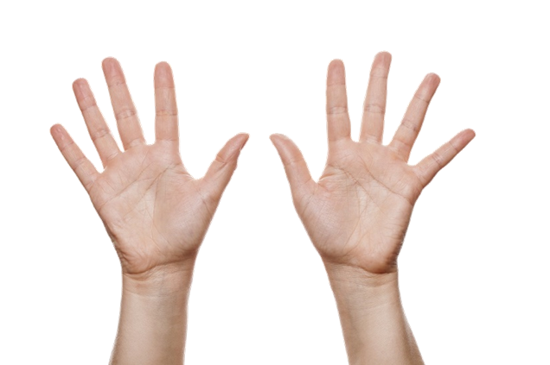

PRESENTATION
An hexadecimal value is expressed with 16 digits
CLASS
A
5
6
9
B
4
3
7
8
C
2
D
A = 10
B = 11
C = 12
D = 13
E = 14
F= 15
1
E
0
F
Each SLOT contains values from 0 to 15

Slide 16
PRESENTATION
Base 16 (hexa) to Base 10 (decimal)
CLASS
14
BASE 16
= 1*16^1 + 4*16^0
1
4
= 16 + 4
= 20
16^4
16^3
16^2
16^1
16^0
BASE 10
4
3
2
1
0

Slide 17
QUESTION
Convert this number to base 10
5 MIN
ONE
251
BASE 16
=
=
2
5
1
=
BASE 10
16^4
16^3
16^2
16^1
16^0
4
3
2
1
0

Slide 18
DISCUSSION
Problem solving
How to convert binary number to hexadecimal number?
10 MIN
GROUP 2
?
BASE 2
BASE 16
?
Q1 : How many bits (slots in base 2) do you need to convert an hexa (1 slot in base16) ?
Q2 : Find a way to convert a number in base 2 to a number in base 16
Q3 : Find a way to convert a number in base 16 to a number in base 2

Slide 19
SOLUTION !
Q2 : Find a way to convert a number in base 2 to a number in base 6
CLASS
E
6
BASE 16
BASE 2
1
1
1
0
0
1
1
0
So : (E6)base16 🡺 (1110 0110)base2

Slide 20
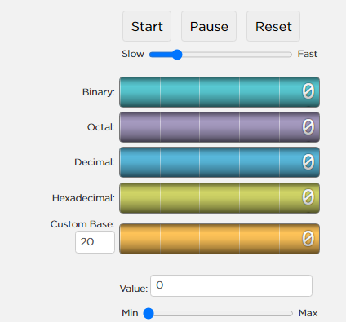
PRACTICE
Explore the odometer
10 MIN
TEAM 2
https://studio.code.org/s/odometer/next
Check the conversions between each bases are right
"What's the largest number you can make in base 2 with the odometer ?

Slide 21
WRAP UP
What did we learn today ?
Explain on whiteboard what you understood about today session
BASE 8
BASE 16

Slide 22
HOMEWORK
HOMEWORK
BASES CONVERSIONS

